Slide 1


Medical Health Expenses Prediction
By – Milind Udbhav

Slide 2




Understanding Problem Statement
Predict the future medical expenses of patients based on certain features.
Factors affecting the medical expenses of the patients:-
Age
Gender
Body Mass Index
Region
Smoking Behaviour

Slide 3

Business Implications of the Project
Health is the center of everyone’s life.
Every part of our life relies on good health.
Health is the extent of an individual’s continuing physical, emotional, mental, and social ability to cope with the environment.

Slide 4

Univariate Analysis
It involves only one variable.
It is used to understand the distribution of the variables present in the dataset and derive meaningful insights from them.
It can be used to check the distribution of both Numerical as well as Categorical variables.

Slide 5
Bivariate Analysis
Bivariate Analysis is one of the simplest forms of quantitative analysis.
It involves analysis of two variables for determining the empirical relationship between them.
It can be helpful in testing simple hypothesis of association.

Slide 6
Feature Scaling
Feature Scaling is used to normalize the range of independent variables or features of data.
Feature Scaling is also known as Data Normalization.
It helps to normalize the data within a particular range.
It also helps in speeding up the calculations in an algorithm.

Slide 7
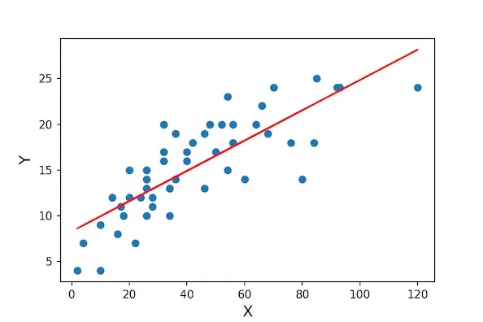
Linear Regression
Linear Regression is a linear approach of modelling the relationship between a dependent and one or more independent variables.

Slide 8
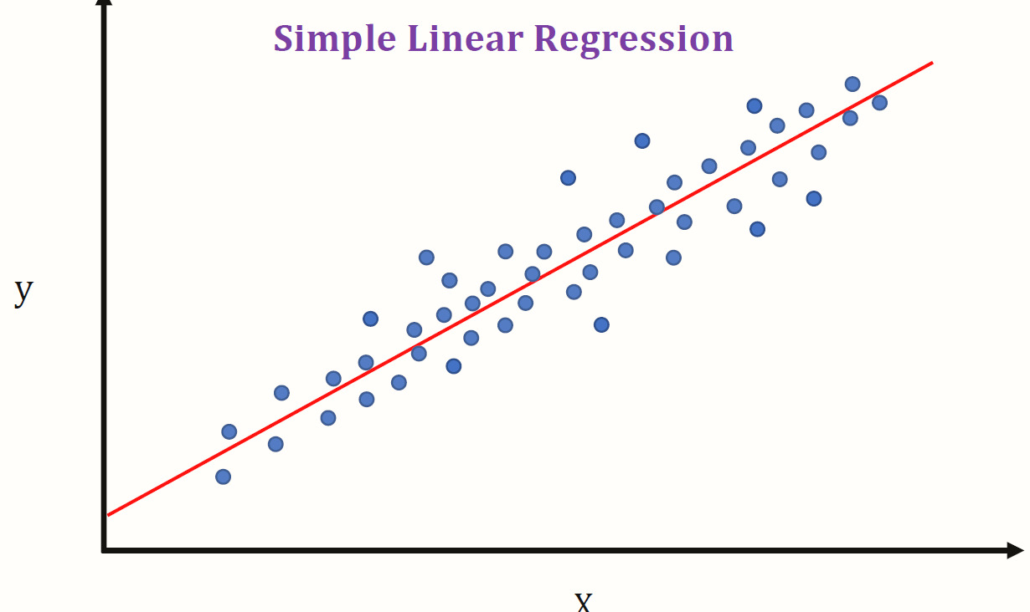
Assumptions of Linear Regression
Linearity
The relationship between the dependent and the independent variables must be linear.
Trend lines between two variables must be either in increasing or decreasing pattern.

Slide 9
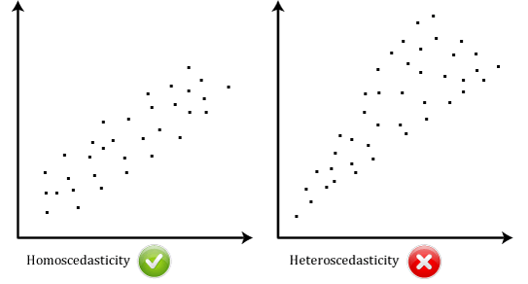
Assumptions of Linear Regression
Homoscedasticity
In statistical terms, the variance of all the variables must be same.

Slide 10
Assumptions of Linear Regression
Independence
All the observations must be independent of each other.
Normality
All the variables must follow a normal distribution.

Slide 11
Evaluation Metrics
R2 Score
It is generally used to determine the strength of correlation between the independent features and the target column.
Root Mean Squared Error(RMSE)
It is the square root of the mean of the differences between actual and the predicted values.

Slide 12

Random Forest
Random forest is an ensemble learning method for classification and regression by constructing multiple number of decision trees at training time.
And it outputs the average prediction of the individual trees in case of regression and mode of the classes in case of classification.

Slide 13
Gradient Boosting Model
Gradient boosting works sequentially adding the previous predictors under fitted predictions to the ensemble.
In case of Gradient boosting, ensembling happens sequentially.
The model is built until and unless the errors are optimised in the best way.

Slide 14
Cross Validation
Cross Validation is a resampling procedure which is used to evaluate the machine learning models on limited data samples.
The goal of cross validation is to test the model’s ability to predict new data.
It has a single parameter called k.
k indicates the number of groups the data would be split into.

Slide 15
More things to try
We can give different labels to each Region. It might give better results.
Keep 4 and 5 number of children in our analysis instead of capping them and see how the results vary.
We can try some more predictive models and compare the results.
Try converting Expense column to a normal distribution using log or square root transformation.

Slide 16
Major Takeaways from the project
Understood the importance of Data Analysis and Data Visualization for determining the association between features.
How to build intuition by building insights from Data Visualization.
How to deal with categorical variables.
Learnt about different Assumptions to be satisfied before using a Linear Regression Model.

Slide 17
Major Takeaways from the project
Learned different predictive models such as Linear Regression, Random Forest and Gradient Boosting model.
Learned how to ensemble different models.
Understood the importance of cross validation on the data.
Learned the importance of comparing different predictive models.

Slide 18

Thank you !

